Slide 1
RUSTikales Rust for advanced coders

Slide 2
Plan for today

Slide 3
Plan for today
Recap

Slide 4
Plan for today
Recap
Slices

Slide 5
Recap

Slide 6
Recap
References by default are very unsafe

Slide 7
Recap
References by default are very unsafe
Static analysis required to guarantee memory safety

Slide 8
Recap
References by default are very unsafe
Static analysis required to guarantee memory safety
Borrow Checker
Reference mutably borrowed twice+ → Not allowed, illegal
Reference mutably borrowed once → No other borrows allowed
Reference immutably borrowed → Only other immutable borrows allowed
Reference may not outlive borrowed data

Slide 9
Recap
References by default are very unsafe
Static analysis required to guarantee memory safety
Borrow Checker
Borrow Checker evaluates Lifetimes of all values

Slide 10
Recap
References by default are very unsafe
Static analysis required to guarantee memory safety
Borrow Checker
Borrow Checker evaluates Lifetimes of all values
Lifetimes are complicated...
Variable → The scope they‘re defined in
Value → Dropped when owner dropped
Reference → Well...

Slide 11
Recap
References by default are very unsafe
Static analysis required to guarantee memory safety
Borrow Checker
Borrow Checker evaluates Lifetimes of all values
Lifetimes are complicated...
Lifetime of a reference → Not only when, but where

Slide 12
Recap
References by default are very unsafe
Static analysis required to guarantee memory safety
Borrow Checker
Borrow Checker evaluates Lifetimes of all values
Lifetimes are complicated...
Lifetime of a reference → Not only when, but where
A region of code in which the reference must be valid
Between assigning and using the reference
Can have gaps
Non-Lexical Lifetime → Not limited to scopes

Slide 13
Recap
References by default are very unsafe
Static analysis required to guarantee memory safety
Borrow Checker
Borrow Checker evaluates Lifetimes of all values
Lifetimes are complicated...
Lifetime of a reference → Not only when, but where
A region of code in which the reference must be valid
A region of memory where the reference may point into
When using the reference, the original value must be alive

Slide 14
Recap
References by default are very unsafe
Static analysis required to guarantee memory safety
Borrow Checker
Borrow Checker evaluates Lifetimes of all values
Lifetimes are complicated...
Lifetime of a reference → Not only when, but where
Compiler is very good at figuring out lifetimes
Lifetime Elision
Sometimes, we have to specify them ourselves → Named lifetime parameters

Slide 15
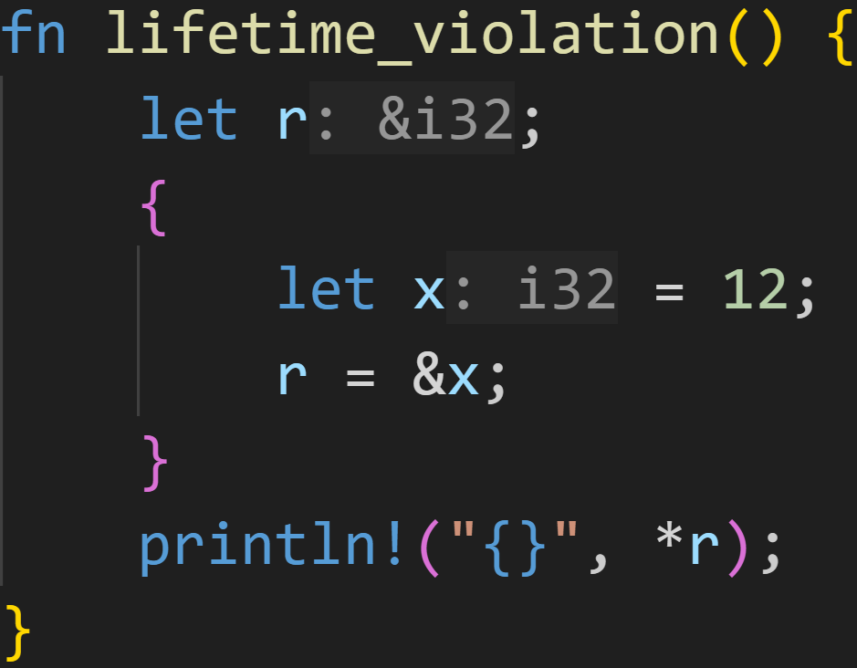
Recap

Slide 16
Recap
Lifetime of &x

Slide 17
Recap
Lifetime of x
Lifetime of &x

Slide 18
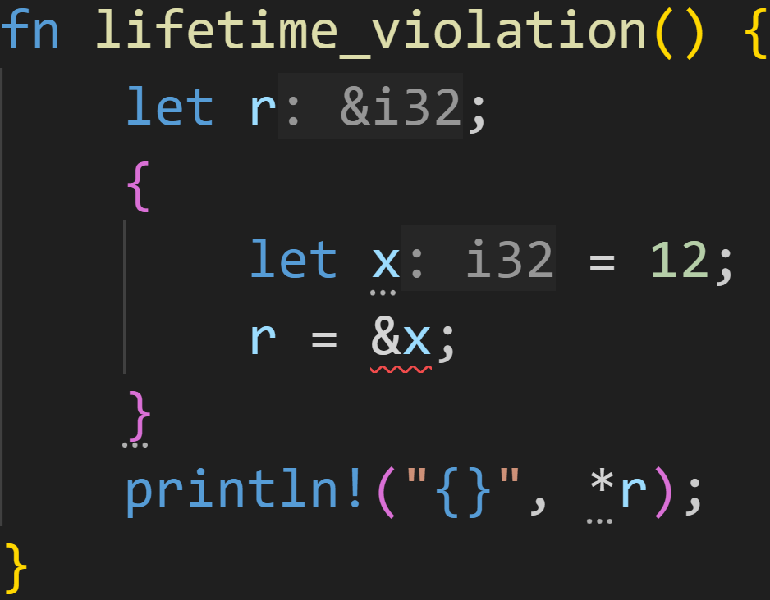
Recap
Lifetime of x
Lifetime of &x
&x outlives x, this is not allowed!

Slide 19
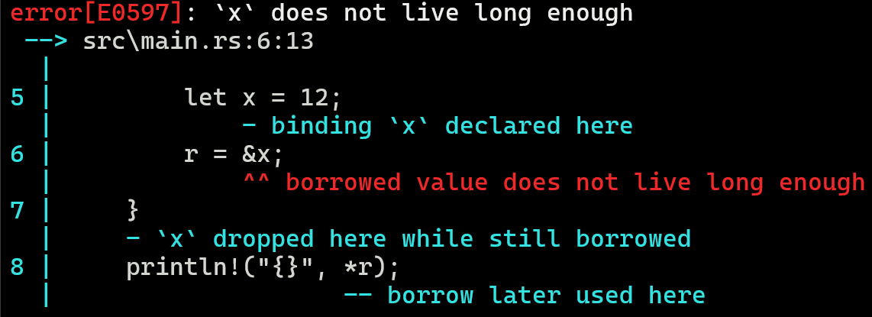
Recap

Slide 20
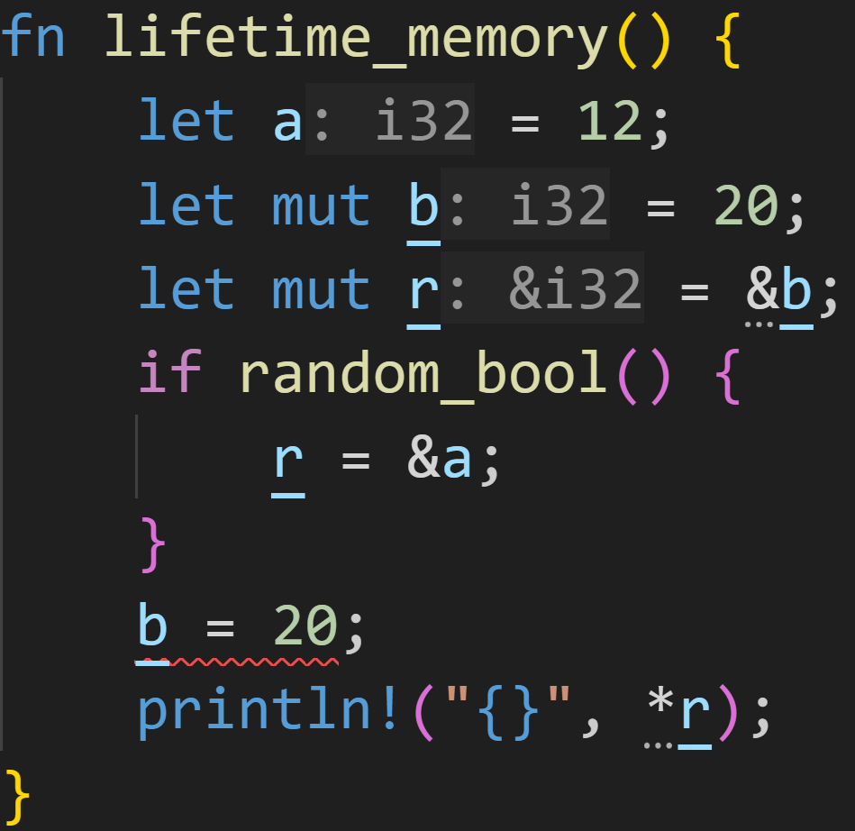
Recap

Slide 21
Recap
Lifetime of &b

Slide 22
Recap
Lifetime of &b
Lifetime of &a

Slide 23
Recap
Lifetime of &b
Lifetime of &a
Everything is fine, r does not outlive a and b, however...

Slide 24
Recap
Lifetime of &b
Lifetime of &a
Everything is fine, r does not outlive a and b, however...
We modify b here, while it‘s borrowed! Not allowed.

Slide 25
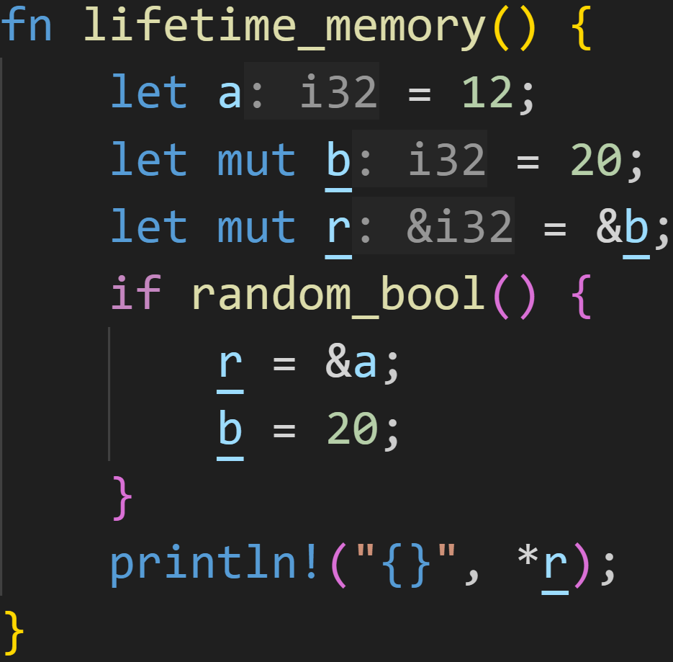
Recap
Two things can happen here:
random_bool() is either true or false

Slide 26
Recap
Two things can happen here:
random_bool() is either true or false
→ TRUE
Lifetime of &b
Lifetime of &a

Slide 27
Recap
Two things can happen here:
random_bool() is either true or false
→ TRUE
Lifetime of &b
Lifetime of &a
Modifying b is allowed, r doesn‘t need it

Slide 28
Recap
Two things can happen here:
random_bool() is either true or false
→ FALSE
Lifetime of &b
We never modify b if random_bool() is false :^)

Slide 29
Recap
Two things can happen here:
random_bool() is either true or false
In both cases, no lifetimes are violated
→ Code allowed

Slide 30
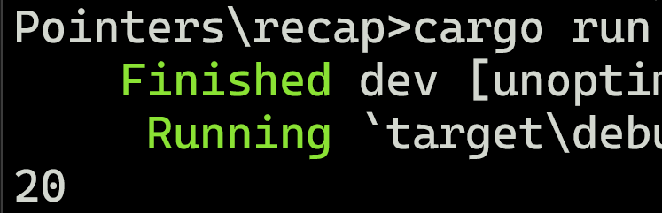
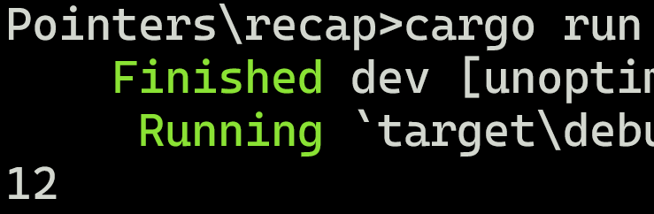
Recap
Two things can happen here:
random_bool() is either true or false
In both cases, no lifetimes are violated
→ Code allowed

Slide 31
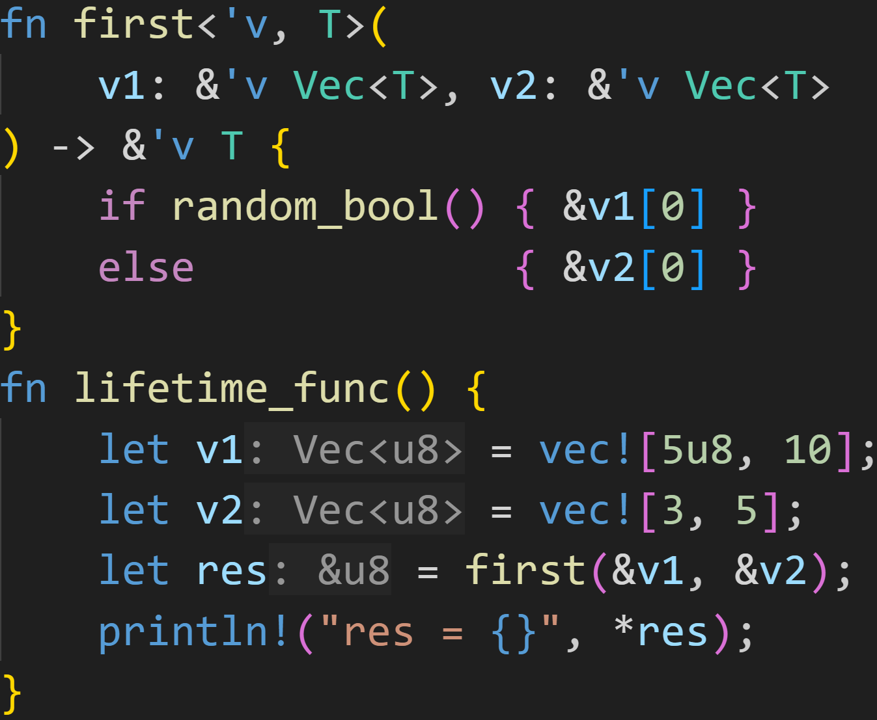
Recap

Slide 32
Recap
Named lifetime parameter

Slide 33
Recap
Lifetime parameters and generic parameters can be used together, but lifetimes have to come first!

Slide 34
Recap
For a small moment in time, there exists a lifetime which borrows from both v1 and v2 at the same time

Slide 35
Recap
For a small moment in time, there exists a lifetime which borrows from both v1 and v2 at the same time
In this region, we also borrowed v1 and v2

Slide 36
Slices

Slide 37
Slices
Imagine you want to write an efficient tokenizer
Tokenizer: Turns some source text into tokens for further processing, e.g. parsing

Slide 38
Slices
Imagine you want to write an efficient tokenizer
Given a source text (a String), we want to get a sequence of words
Word: Any sequence of alphanumeric (a, 1, U) characters
We want to ignore all other characters, and skip them

Slide 39
Slices
Imagine you want to write an efficient tokenizer
Given a source text (a String), we want to get a sequence of words
Example: „Hello, how are you?“ → [„Hello“, „how“, „are“, „you“]

Slide 40
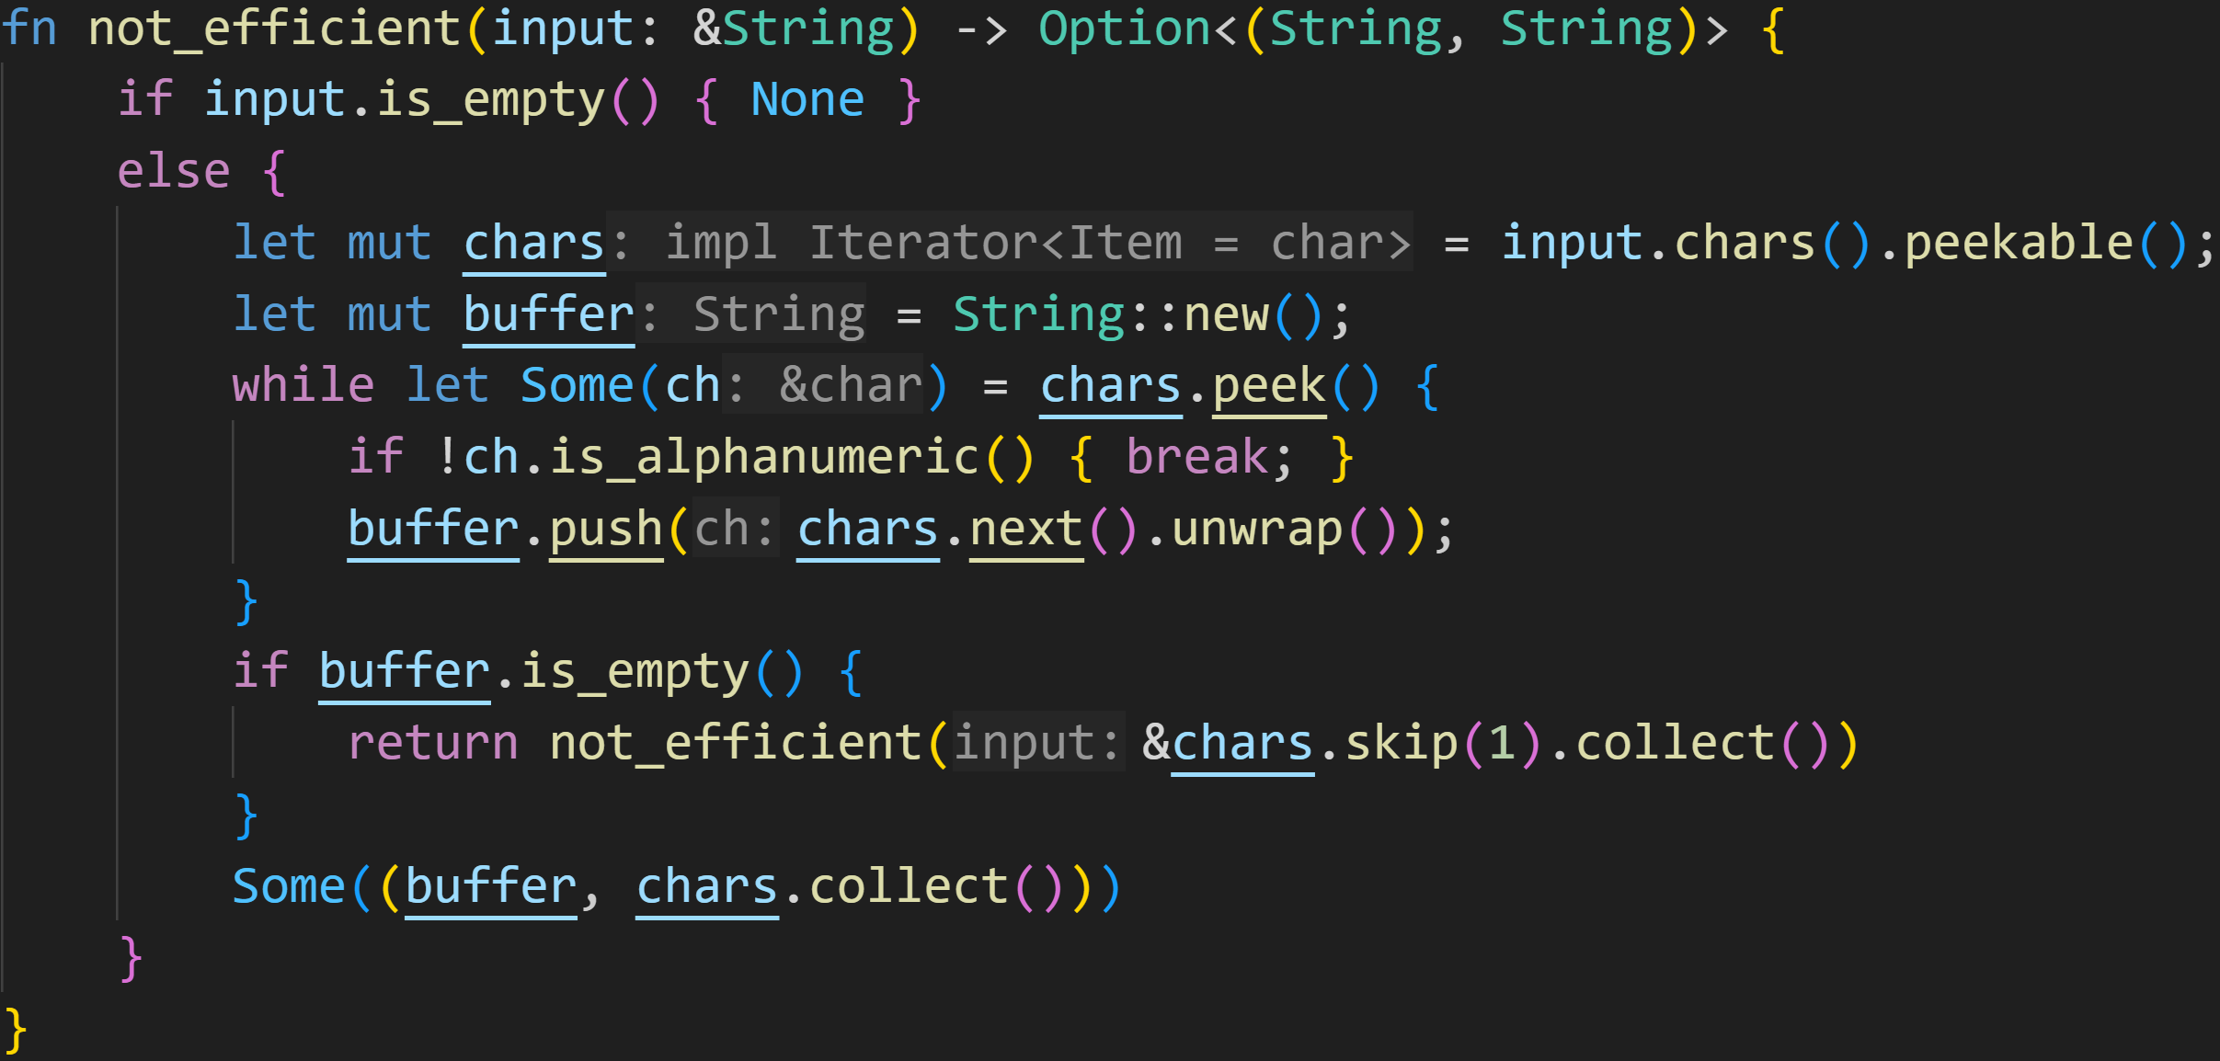
Slices

Slide 41
Slices
Return a pair of (word, rest of input)

Slide 42
Slices
Empty String is trivial

Slide 43
Slices
Rust Strings are UTF-8 encoded, getting the characters is non-trivial :^)
But thankfully iterators are lazy (only compute when necessary)

Slide 44
Slices
While there‘s a letter or number in front, fill the buffer

Slide 45
Slices
empty buffer → Special character at the front, skip it and try again

Slide 46
Slices
return the Strings

Slide 47
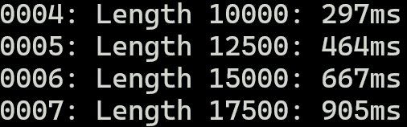
Slices
A second to tokenize a String of 20.000 characters!!

Slide 48
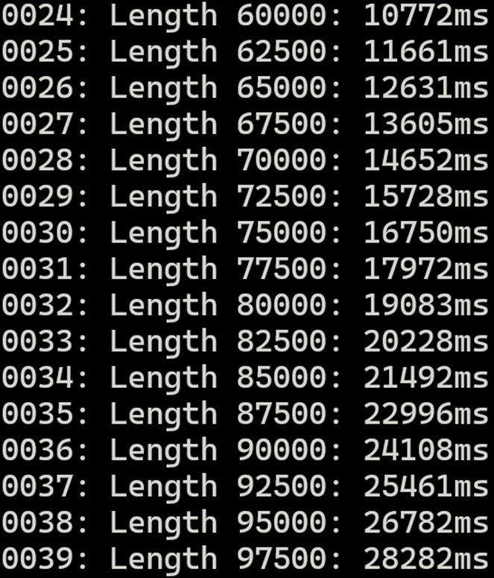
Slices
This is fine...

Slide 49
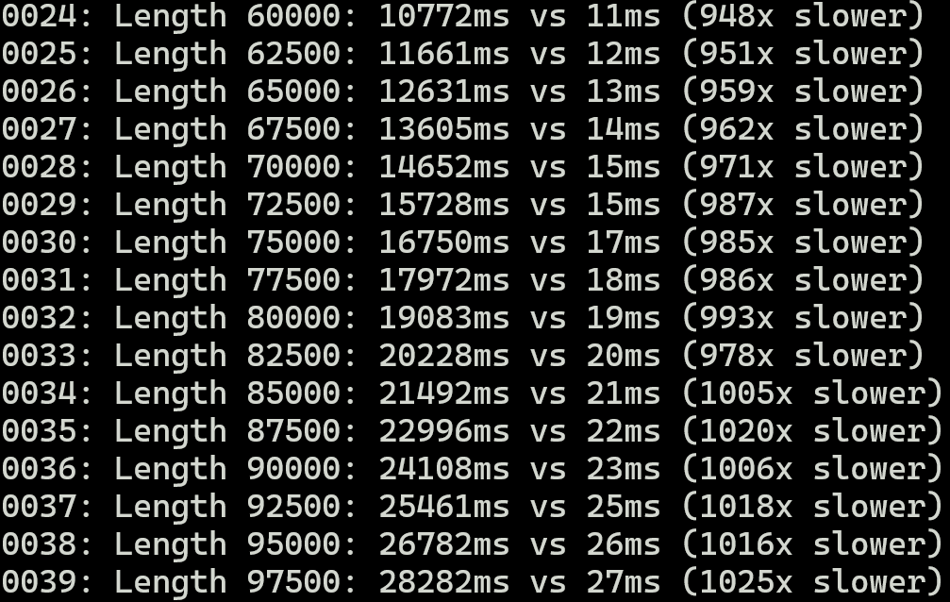
Slices
But we can do better :^)

Slide 50
Slices
Why is this not efficient?

Slide 51
Slices
Heap allocations
Collecting iterators (making copies of the input)
Why is this not efficient?

Slide 52
Slices
What‘s the problem?

Slide 53
Slices
What‘s the problem?
There are many problems, but the biggest problem is creating new Strings

Slide 54
Slices
What‘s the problem?
There are many problems, but the biggest problem is creating new Strings
Wouldn‘t it be nice if we could reuse the original string? Maybe point into it? Take substrings?

Slide 55
Slices
What‘s the problem?
There are many problems, but the biggest problem is creating new Strings
Wouldn‘t it be nice if we could reuse the original string? Maybe point into it? Take substrings?
Yes, of course we can, and we should

Slide 56
Slices
Rustdocs: „Slices let you reference contiguous sequences in collections, instead of the whole collection“

Slide 57
Slices
Rustdocs: „Slices let you reference contiguous sequences in collections, instead of the whole collection“
The most commonly seen form of Slices is the String Slice &str

Slide 58
Slices
Rustdocs: „Slices let you reference contiguous sequences in collections, instead of the whole collection“
The most commonly seen form of Slices is the String Slice &str
Slices are special references which are made out of two fields
A pointer into the collection
A length → How big is the slice

Slide 59
Slices
Rustdocs: „Slices let you reference contiguous sequences in collections, instead of the whole collection“
The most commonly seen form of Slices is the String Slice &str
Slices are special references which are made out of two fields
The type signature for Slices is [T]
Slices do NOT implement the Sized trait → can‘t use [T] itself, you always need a reference

Slide 60
Slices
Rustdocs: „Slices let you reference contiguous sequences in collections, instead of the whole collection“
The most commonly seen form of Slices is the String Slice &str
Slices are special references which are made out of two fields
The type signature for Slices is [T]
You can get a Slice of a collection by using ranges as indices

Slide 61
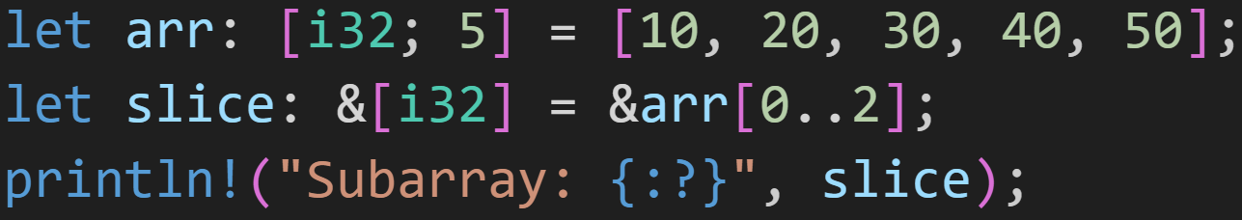
Slices

Slide 62
Slices
Slice of an i32-array

Slide 63
Slices
Range start is inclusive
Range end is exclusive
→ The slice refers to indices 0 and 1

Slide 64

Slices
Range start is inclusive
Range end is exclusive
→ The slice refers to indices 0 and 1

Slide 65
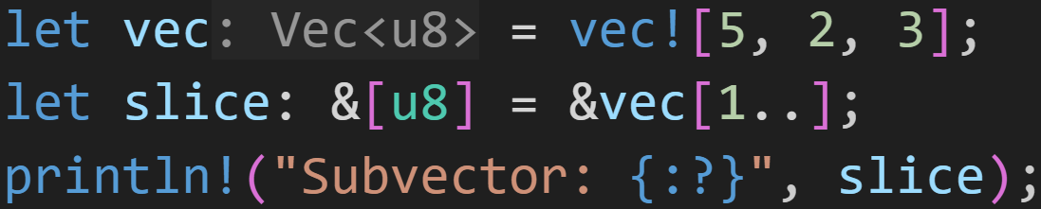
Slices

Slide 66
Slices
You can also slice into Vectors

Slide 67
Slices
You can omit start and end
→ default start is index 0 → default end is last index

Slide 68

Slices
You can omit start and end
→ default start is index 0 → default end is last index

Slide 69
Slices
Rustdocs: „Slices let you reference contiguous sequences in collections, instead of the whole collection“
The most commonly seen form of Slices is the String Slice &str
Slices are special references which are made out of two fields
The type signature for Slices is [T]
You can get a Slice of a collection by using ranges as indices
As Slices are references, normal Ownership and Borrow Checker rules apply
While you borrow a Slice of a collection, you can‘t modify it
Slices don‘t own any elements
No Moves or Copies happen

Slide 70
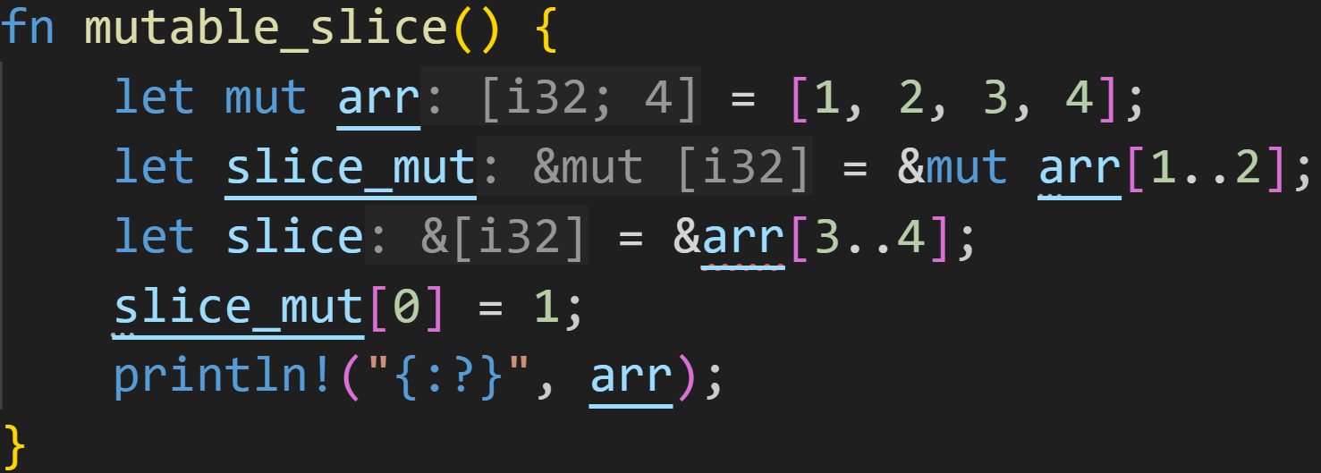
Slices

Slide 71
Slices
lifetime of mutable borrow

Slide 72
Slices
lifetime of immutable borrow lifetime of mutable borrow

Slide 73
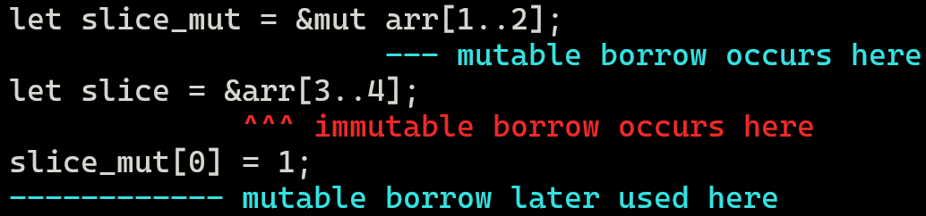
Slices
lifetime of immutable borrow lifetime of mutable borrow

Slide 74
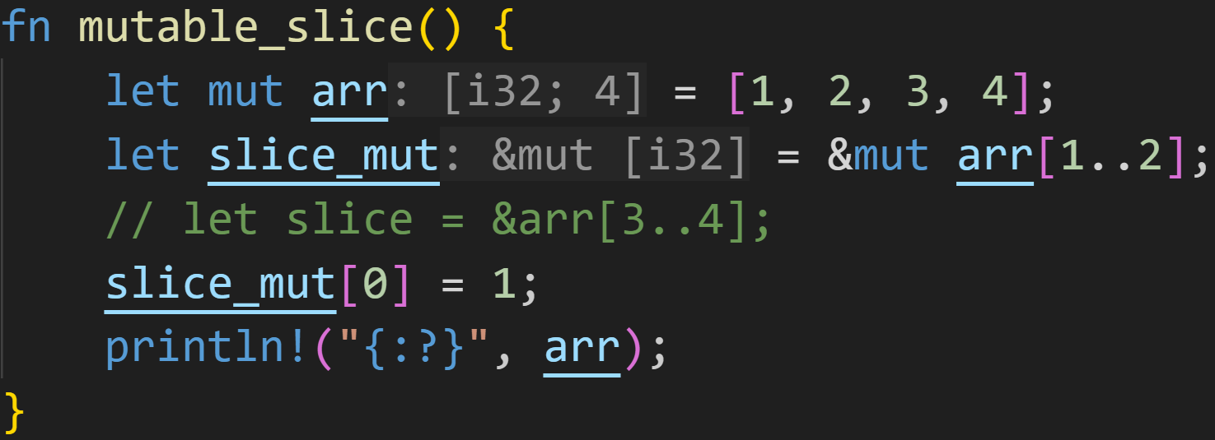
Slices

Slide 75
Slices
Slice index 0 → Array index 1 gets set to 1

Slide 76

Slices
Slice index 0 → Array index 1 gets set to 1

Slide 77
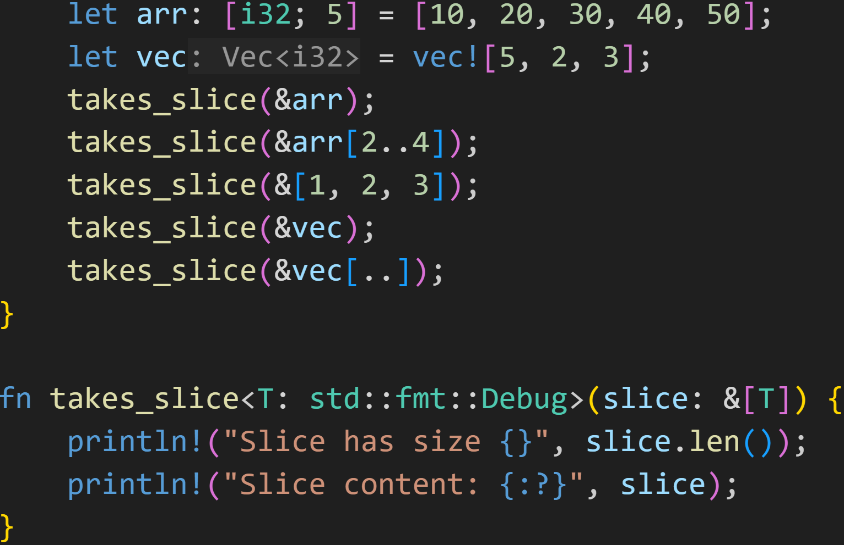
Slices

Slide 78
Slices
Slices allow us to efficiently and quickly get sub-collections of any size, and pass them to different functions

Slide 79
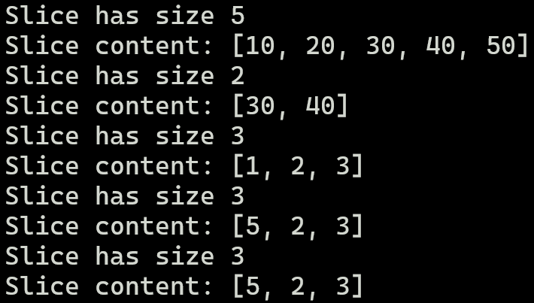
Slices

Slide 80
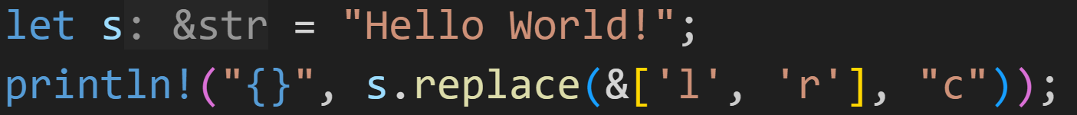
Slices

Slide 81
Slices
Many functions in the standard library accept slices
→ Here: Replace every „l“ and „r“ in the String s with a „c“

Slide 82

Slices
Many functions in the standard library accept slices
→ Here: Replace every „l“ and „r“ in the String s with a „c“

Slide 83
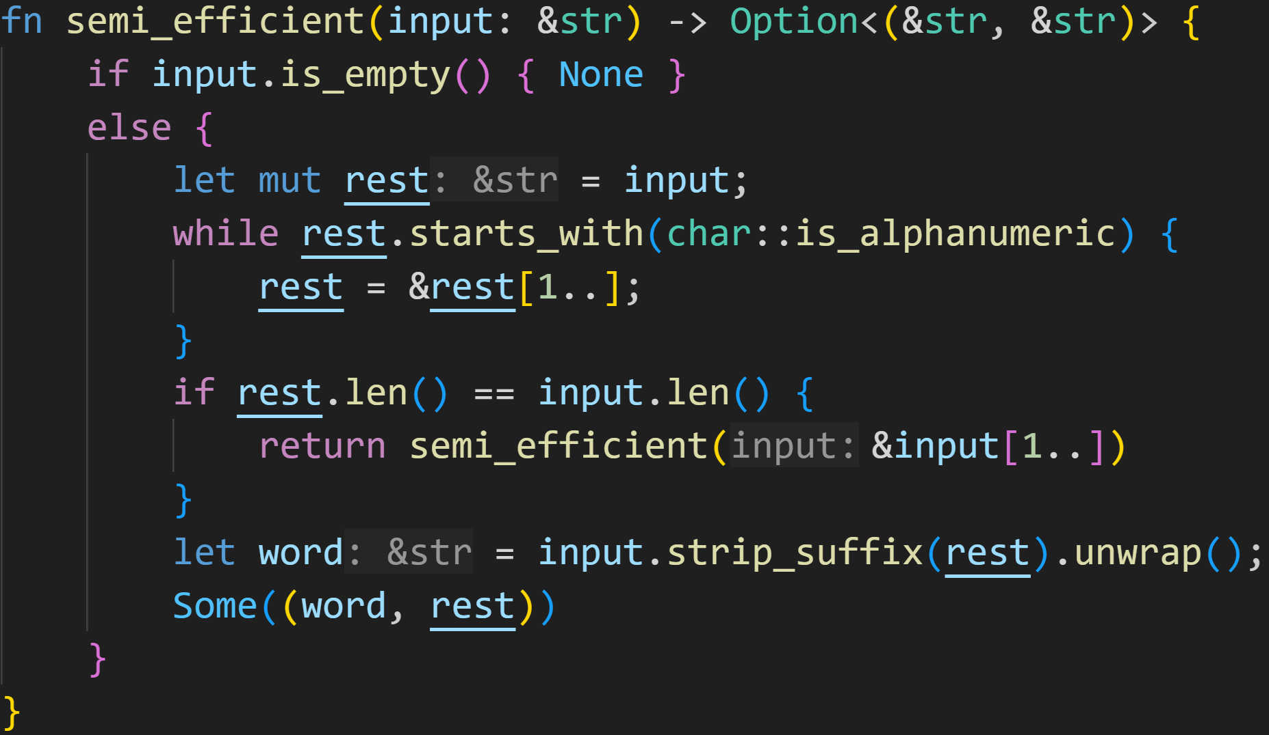
Slices

Slide 84
Slices
Slices into the original string

Slide 85
Slices
Stripping off all alphanumeric characters

Slide 86
Slices
Here we go to the next character

Slide 87
Slices
rest == input iff no alphanumeric character was found at the start → special character

Slide 88
Slices
Actual word is input - rest

Slide 89
Slices
Stack
input | ptr | 0x0
 | len | 6
Memory
0x0 | H
0x1 | E
0x2 | L
0x3 | L
0x4 | O
0x5 | !

Slide 90
Slices
Stack
input | ptr | 0x0
 | len | 6
rest | ptr | 0x0
 | len | 6
Memory
0x0 | H
0x1 | E
0x2 | L
0x3 | L
0x4 | O
0x5 | !

Slide 91
Slices
Stack
input | ptr | 0x0
 | len | 6
rest | ptr | 0x0
 | len | 6
Memory
0x0 | H
0x1 | E
0x2 | L
0x3 | L
0x4 | O
0x5 | !
Next slice is at the first element of rest, until the end of rest

Slide 92
Slices
Stack
input | ptr | 0x0
 | len | 6
rest | ptr | 0x1
 | len | 5
Memory
0x0 | H
0x1 | E
0x2 | L
0x3 | L
0x4 | O
0x5 | !
Next slice is at the first element of rest, until the end of rest...
until it‘s no longer alphanumeric

Slide 93
Slices
Stack
input | ptr | 0x0
 | len | 6
rest | ptr | 0x2
 | len | 4
Memory
0x0 | H
0x1 | E
0x2 | L
0x3 | L
0x4 | O
0x5 | !
Next slice is at the first element of rest, until the end of rest...
until it‘s no longer alphanumeric

Slide 94
Slices
Stack
input | ptr | 0x0
 | len | 6
rest | ptr | 0x3
 | len | 3
Memory
0x0 | H
0x1 | E
0x2 | L
0x3 | L
0x4 | O
0x5 | !
Next slice is at the first element of rest, until the end of rest...
until it‘s no longer alphanumeric

Slide 95
Slices
Stack
input | ptr | 0x0
 | len | 6
rest | ptr | 0x4
 | len | 2
Memory
0x0 | H
0x1 | E
0x2 | L
0x3 | L
0x4 | O
0x5 | !
Next slice is at the first element of rest, until the end of rest...
until it‘s no longer alphanumeric

Slide 96
Slices
Stack
input | ptr | 0x0
 | len | 6
rest | ptr | 0x5
 | len | 1
Memory
0x0 | H
0x1 | E
0x2 | L
0x3 | L
0x4 | O
0x5 | !
At this point, we perform the strip
→ word = HELLO

Slide 97
Slices
Stack
input | ptr | 0x5
 | len | 1
Memory
0x0 | H
0x1 | E
0x2 | L
0x3 | L
0x4 | O
0x5 | !
The caller (hopefully) sets input to rest, and the cycle begins again

Slide 98
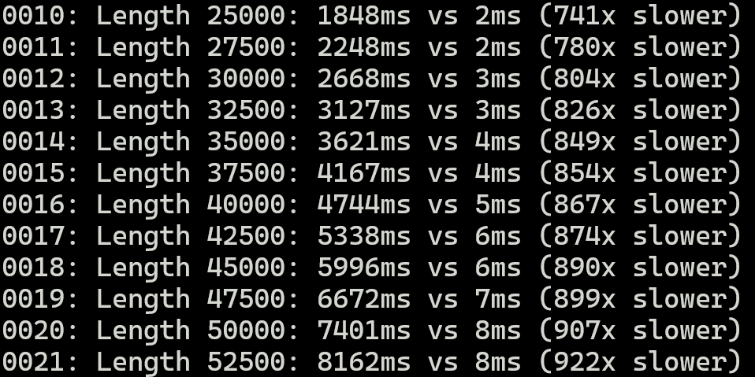
Slices
Nice improvement!

Slide 99
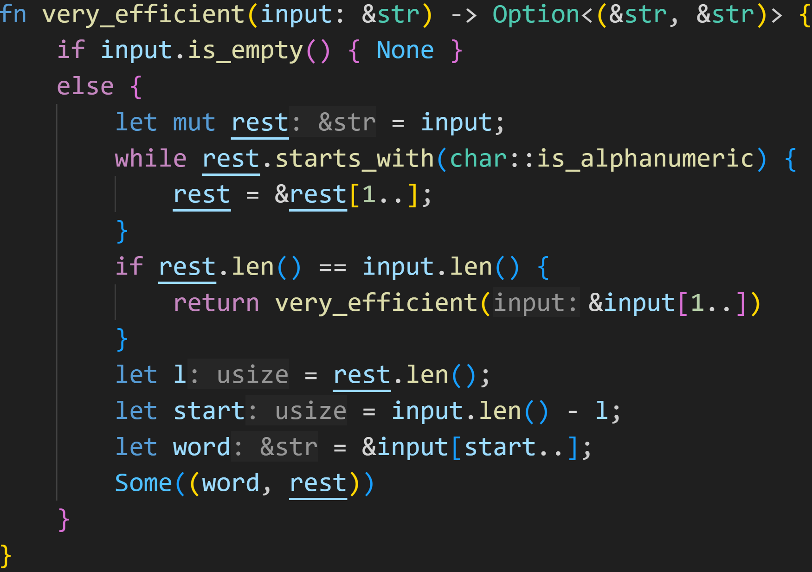
Slices
Pattern Matching is slow, we can do better!

Slide 100
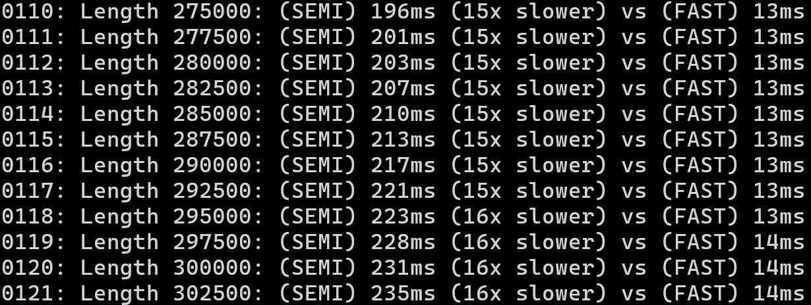
Slices
In debug mode

Slide 101
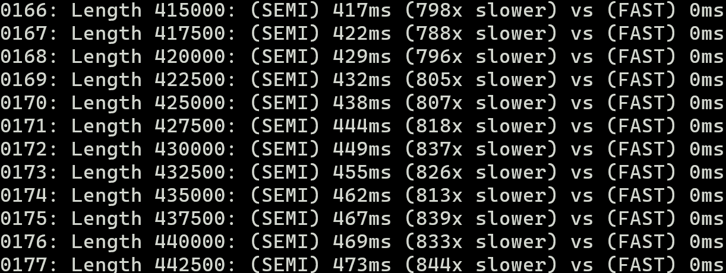
Slices
In release mode

Slide 102
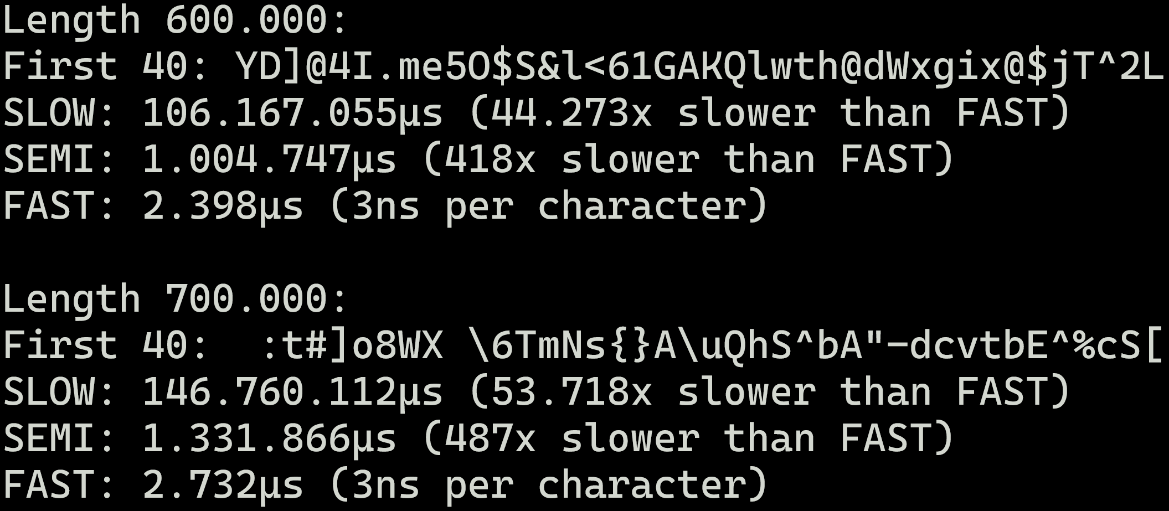
Slices
Rust is a very efficient language, if you know how to utilize it properly

Slide 103
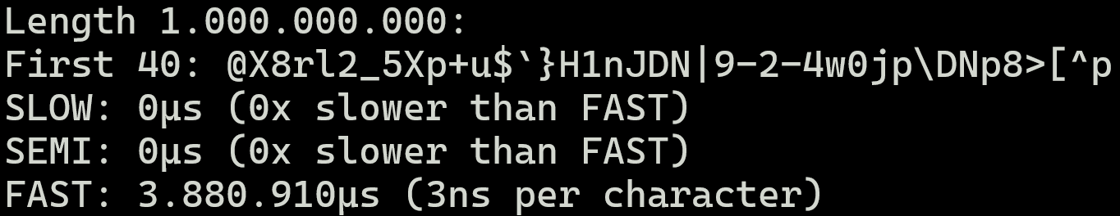
Slices
Rust is a very efficient language, if you know how to utilize it properly
→ 4 seconds to get all words in a string of length 1 billion → Allocating the String almost took longer than that :^) → SLOW would‘ve taken years... Literally

Slide 104
Slices

Slide 105
Slices
Went too close to the sun, and introduced a bug
→ Slices are easy to mishandle

Slide 106
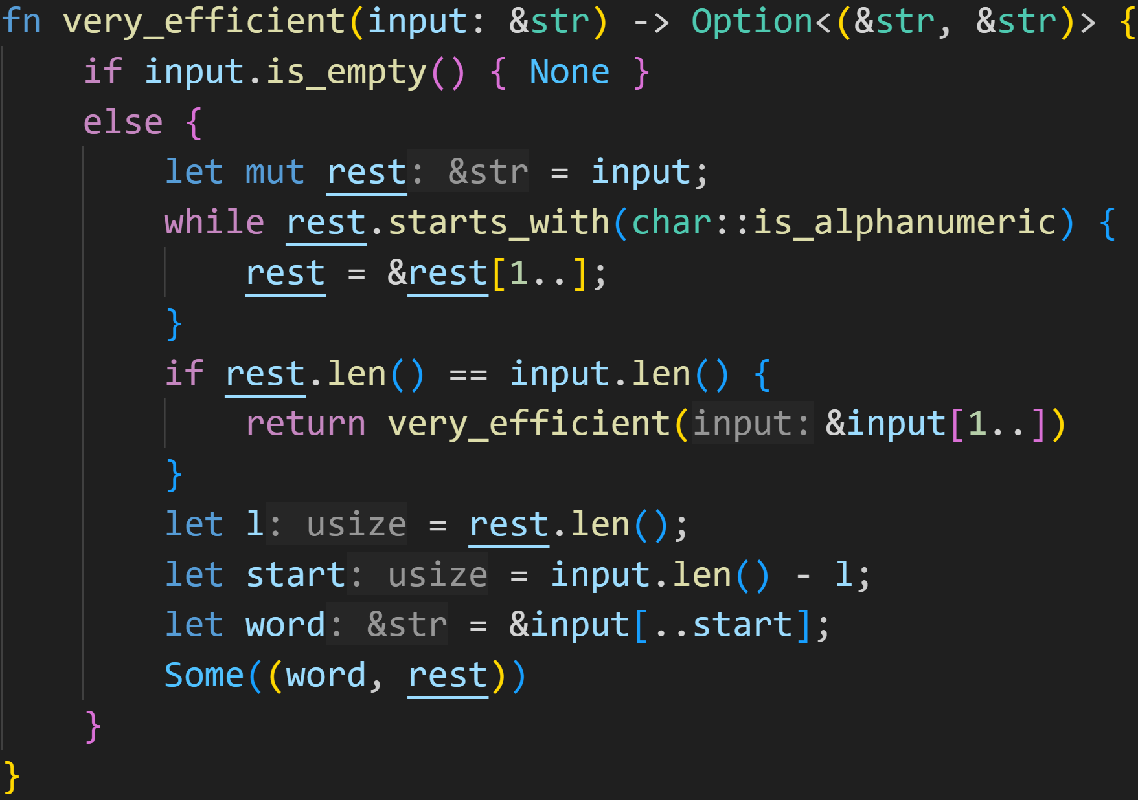
Slices
Of course the word is the start :^)

Slide 107
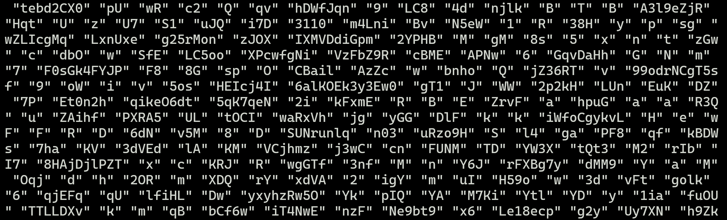
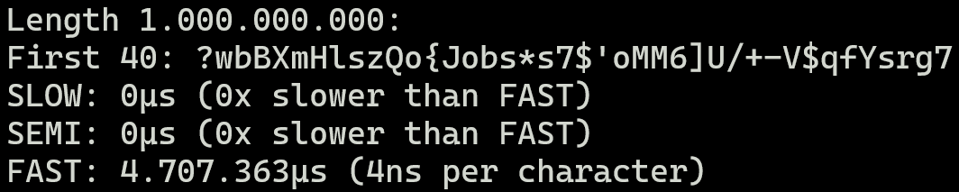
Slices
Subwords:
Still very fast :^)

Slide 108
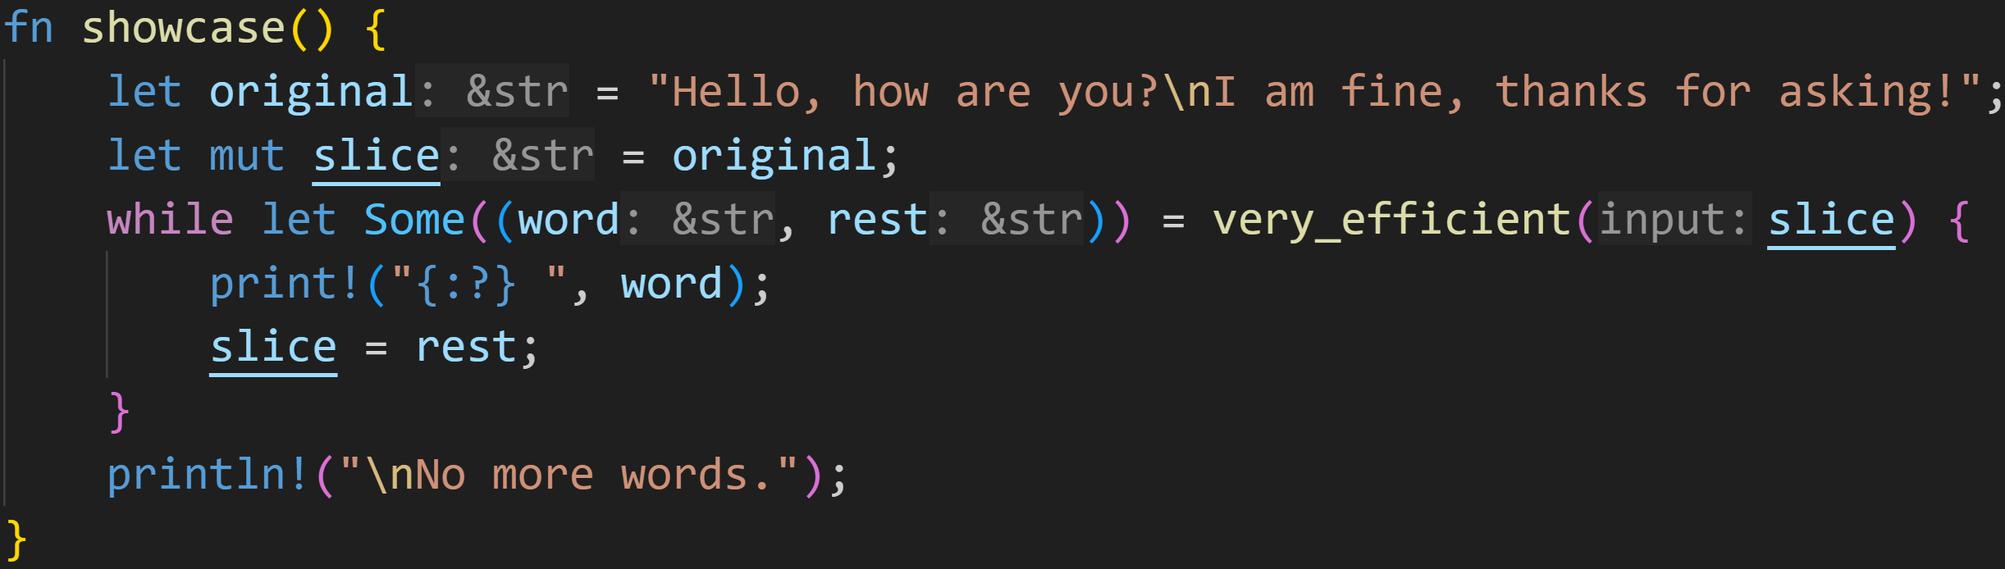
Slices

Slide 109
Slices

Slide 110
Slices
😭

Slide 111



Slices
😭

Slide 112
Slices
😭
Byte indices, not grapheme indices!

Slide 113
Slices
😭
Byte indices, not grapheme indices!
4/3
Exercise for you: Make this code UTF-8 compliant :^)

Slide 114
Slices
😭
Byte indices, not grapheme indices!
4/3
Exercise for you: Make this code UTF-8 compliant :^)
The slow version accepts this string, but is that a good tradeoff?

Slide 115
Slices
Slices are a very powerful tool

Slide 116
Slices
Slices are a very powerful tool
Allow us to efficiently work on sub-collections without copying any data

Slide 117
Slices
Slices are a very powerful tool
Allow us to efficiently work on sub-collections without copying any data
Slices are super fast
Only needs a pointer and a length → CPUs are very good at numbercrunching

Slide 118
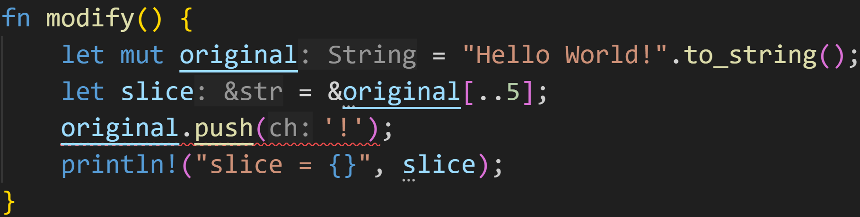
Slices
Slices are a very powerful tool
Allow us to efficiently work on sub-collections without copying any data
Slices are super fast
Because Slices point into the original collection, normal Borrow Checker rules apply

Slide 119
Slices
Slices are a very powerful tool
Allow us to efficiently work on sub-collections without copying any data
Slices are super fast
Because Slices point into the original collection, normal Borrow Checker rules apply
In our original naive String implementation, this would‘ve been allowed → The words were separate from the original text

Slide 120
Next time
Smart Pointers
Rc<T>
RefCell<T>
Declarative Macros

